Slide 1
Administrative Services Advisory Group
Meeting
April 6, 2022

Slide 2
MPCCD General Projects Update Recently Completed Projects 1) Gym walkway at parking lot C entrance 2) Photo lab ventilation upgrade 3) LTC security alarm Board Approved Contracts 1) Admin data center 2) Stadium and softball scoreboards 3) Campus wide bottle fill stations 4) LTC coffee lounge Design / Agency Phase 1) LTC roof and HVAC 2) Gym roof and HVAC 3) MEC lab conversion 4) GA/Nurse plaza 5) Gym central plant 6) LTC fire alarm 7) Smart classroom upgrades

Slide 3
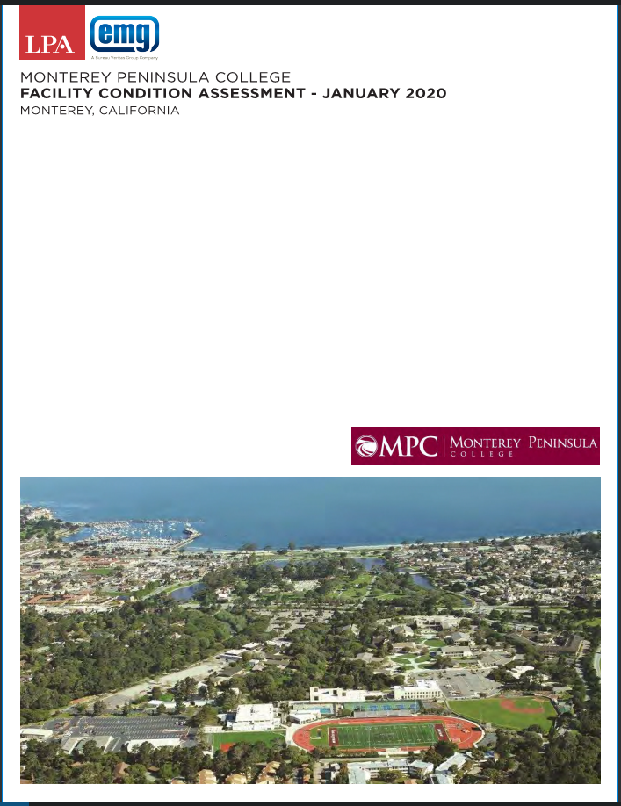
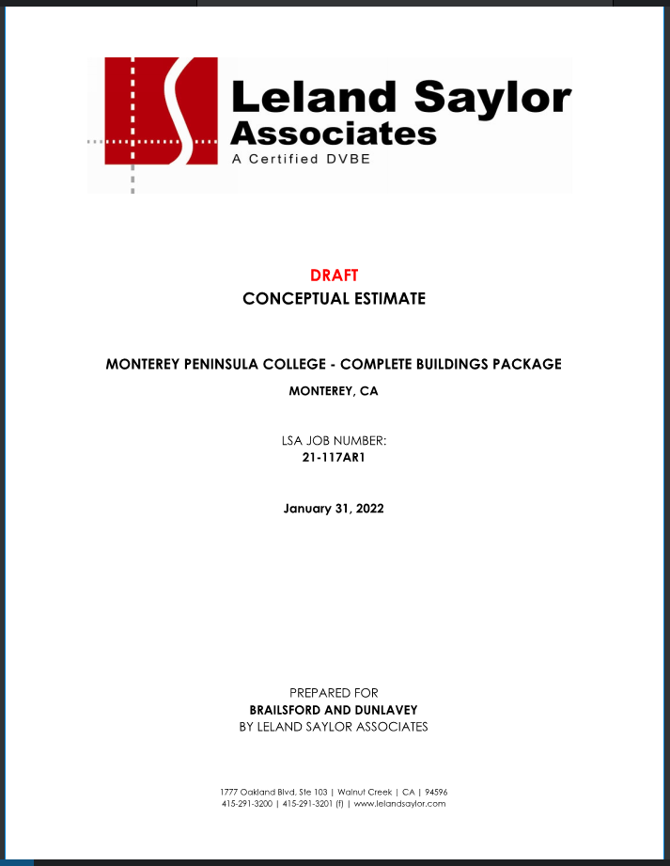
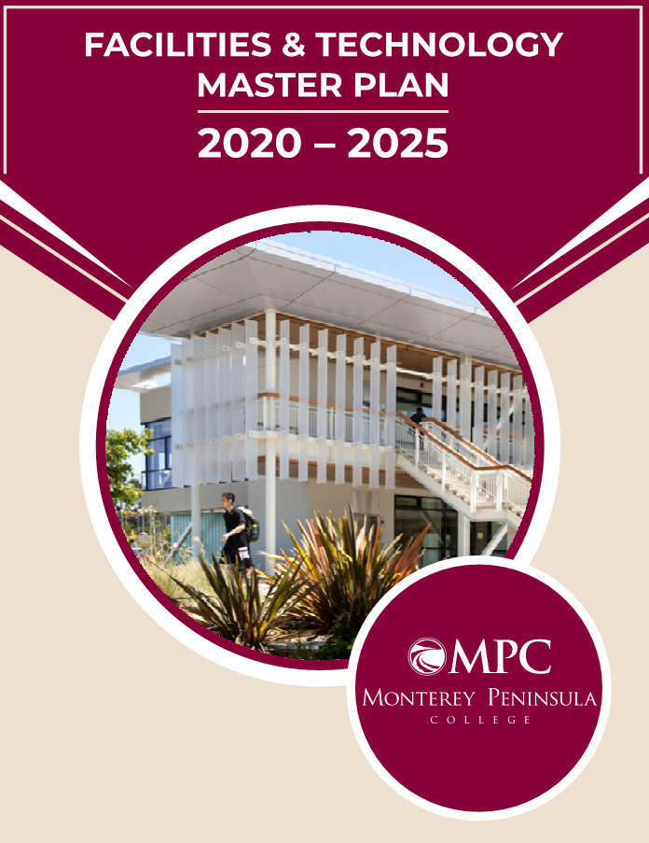
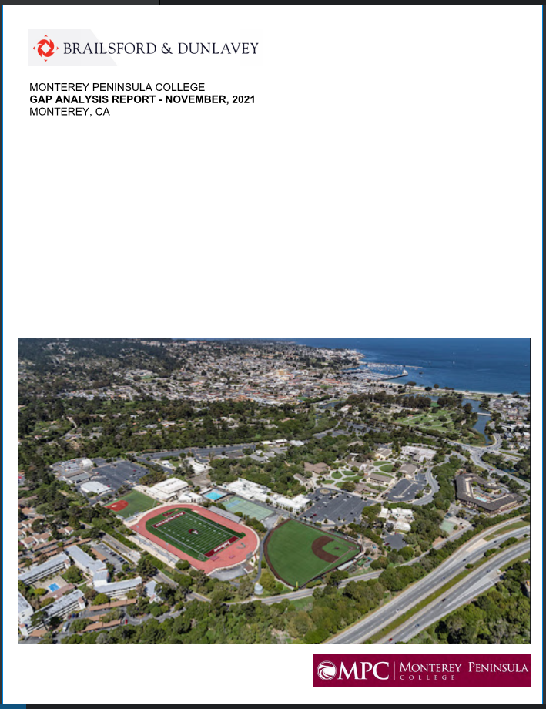
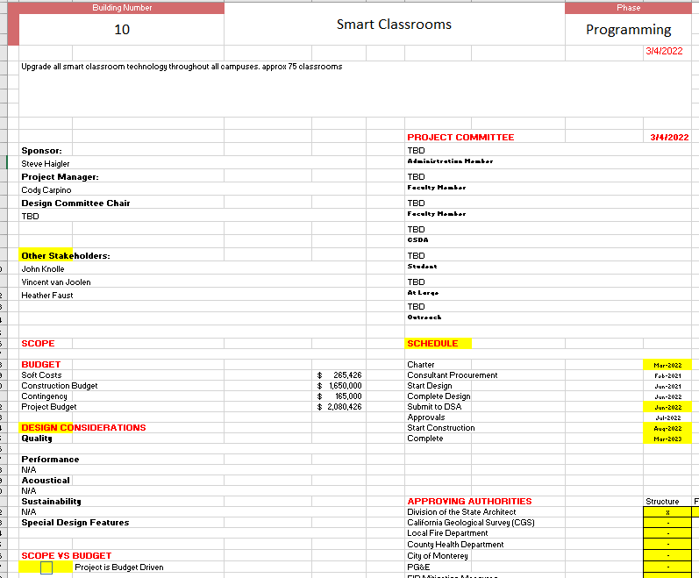
Measure V - Master Budget Process

Slide 4
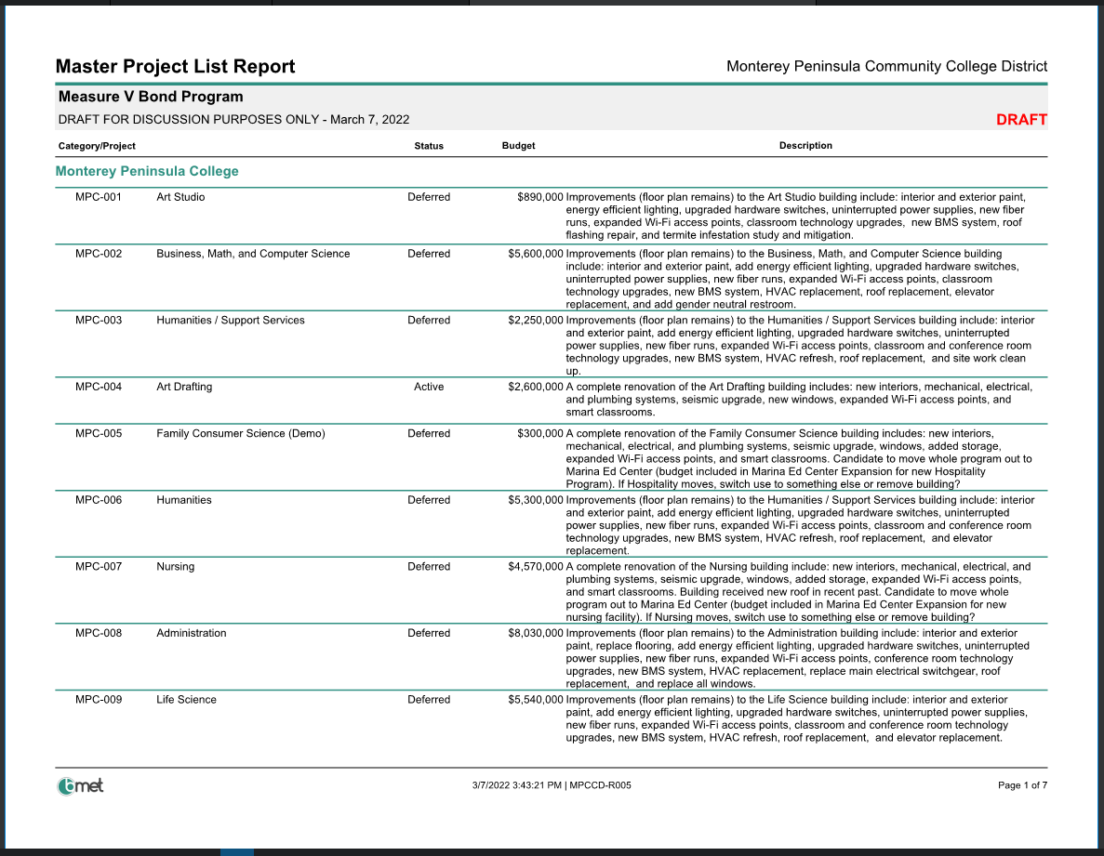
MPCCD Full Need = $423,290,000 Measure V Bond = $230,000,000 What projects are priority and which can be deferred? What scopes and/or budgets can be reduced?

Slide 5
Thank you.
VISIT BDCONNECT.COM FOR MORE INFORMATION.

